Slide 1
Logic Families

Slide 2
Lecture 25 Comparison of logic families
Lecture delivered by:
Deepak V.

Slide 3
Objectives
At the end of this lecture, student will be able to:
Acquire the knowledge of Digital Logic Families
Classify various logic families
Interfacing Logic Families

Slide 4
Topics
Digital Logic Families
Interfacing Logic Families

Slide 5
Logic Families
The different devices use different voltages ranges for their logic levels
They also differ in other characteristics
In order to assure correct operation when gates are interconnected they are normally produced in families
The most widely used families are:
complementary metal oxide semiconductor (CMOS)
transistor-transistor logic (TTL)
emitter-coupled logic (ECL)

Slide 6
Logic families
Logic families can be classified broadly according to the technologies they are
built with
The various technologies are listed below
DL : Diode Logic
RTL : Resistor Transistor Logic
DTL : Diode Transistor Logic
HTL : High threshold Logic
TTL : Transistor Transistor Logic
I2L : Integrated Injection Logic
ECL : Emitter coupled logic
MOS : Metal Oxide Semiconductor Logic (PMOS and NMOS)
CMOS : Complementary Metal Oxide Semiconductor Logic
Among these, only CMOS is most widely used by the ASIC (Chip) designers

Slide 7
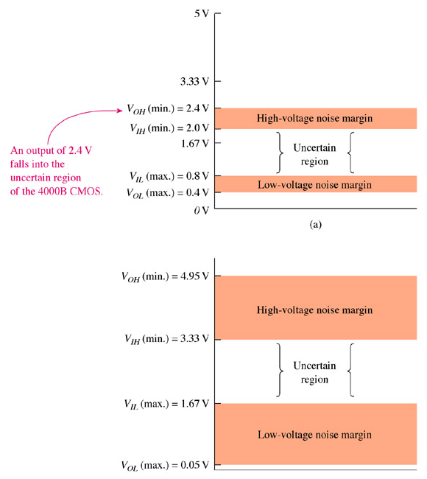
Interfacing Logic Families
TTL to CMOS
38

Slide 8
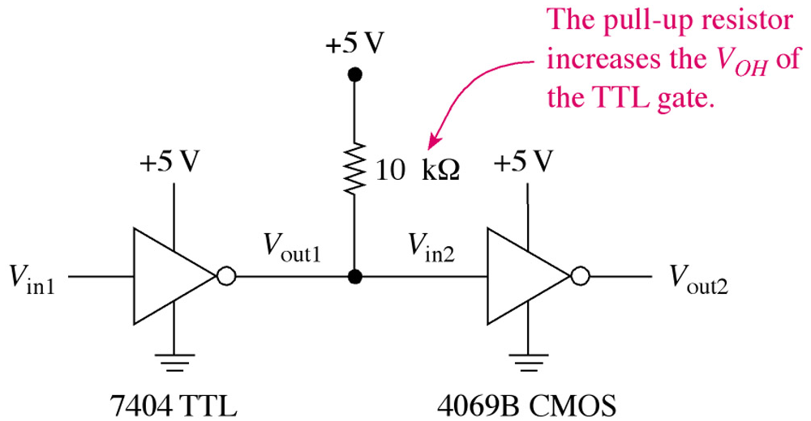
Interfacing Logic Families
TTL to CMOS
Pull-up resistor
39

Slide 9
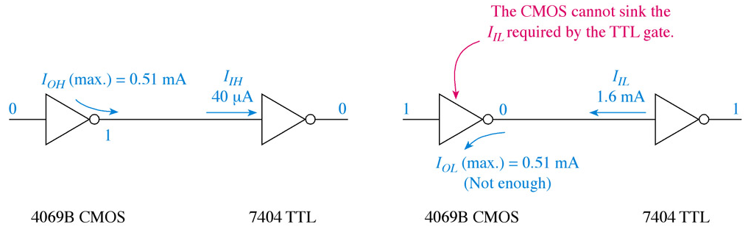
Interfacing Logic Families
CMOS to TTL
40

Slide 10
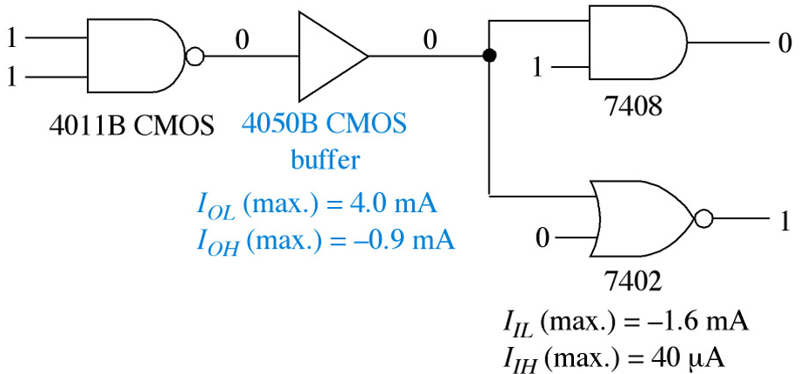
Interfacing Logic Families
CMOS to TTL
41

Slide 11
Interfacing Logic Families
42

Slide 12
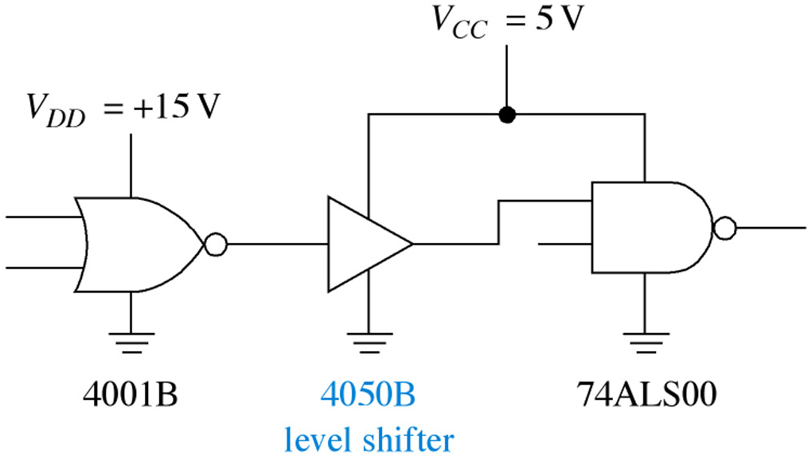
Interfacing Logic Families
Level Shifting
Level-shifter IC: 4050B
43

Slide 13
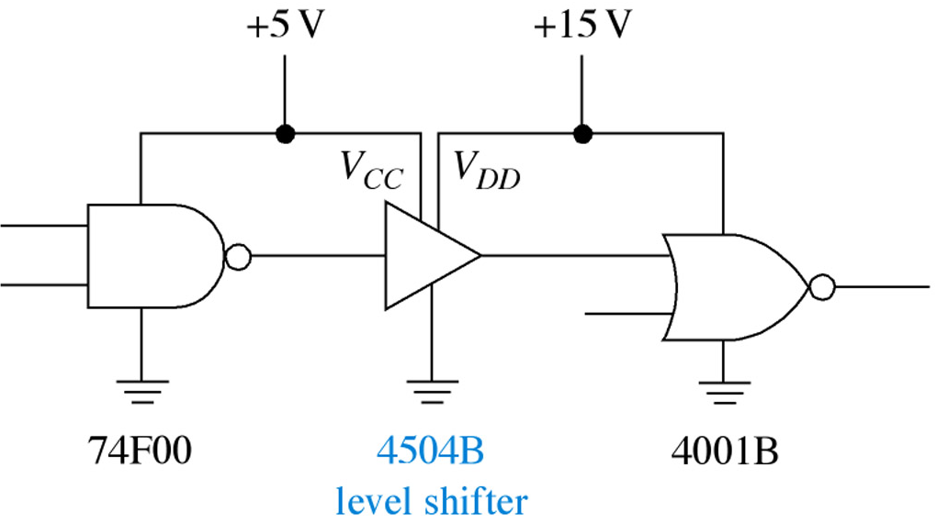
Interfacing Logic Families
Level Shifting
Level-shifter IC: 4504B
44

Slide 14
Interfacing Logic Families
ECL Interfacing
45

Slide 15
Summary
The different devices use different voltages ranges for their logic levels
In order to assure correct operation when gates are interconnected they are normally produced in families
The most widely used families are:
complementary metal oxide semiconductor (CMOS)
transistor-transistor logic (TTL)
emitter-coupled logic (ECL)

